Slide 1

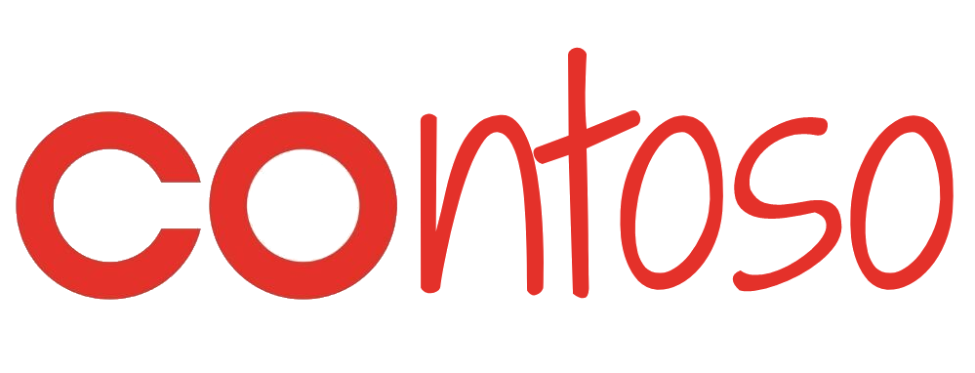
Smart Forecasting
Super Markets
Team Quokka

Slide 2

What is Smarter Forecast?
Smarter Forecast is the advanced analytics solution for Demand Forecasting @ Contoso Supermarkets. Described as the ‘nervous system’ of the Supply Chain, the smarter forecasting model predicts item/day/store forecasts over the next 16 weeks for consumption by the replenishment system.
Having a comprehensive Demand model allows Contoso’s forecasting team to drive many initiatives across the business including what-if simulation tools and recommendations for:
Promotional planning
Smarter Clearance
Dynamic Markdowns
Ranging Reviews

Slide 3

Which areas of the business use Smarter Forecast predictions?
As smarter forecasting becomes a more centralized advanced analytics asset, it will serve different parts of the business via multiple projects. Some of the current uses of Smarter Forecast are:
Promotional Application Used by Promo managers when designing promos
Smarter Clearance to recommend prices to clearance managers to minimise the impact clearance markdowns have on margin
Smarter Forecast for demand forecasting

Slide 4
Drivers for cloud migration
Cost optimization
Resilience
Scalability

Slide 5
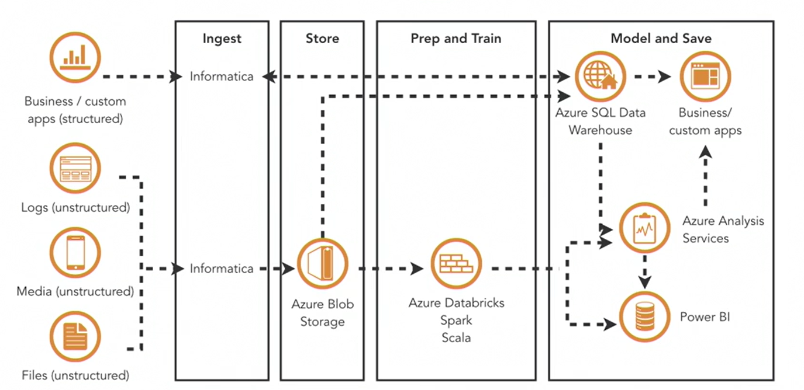
Data warehouse pipeline
Preprocess data (clean, compress, partition)
Evaluate data (visualize, review)
Standard Compute (sum, group)
Complex compute (machine learning)
Serve results (store and present)

Slide 6
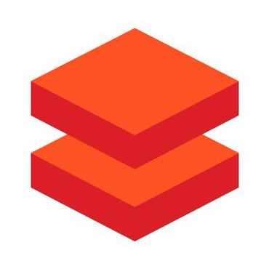




Scenario 1 – Continuous Integration
1
2
Dev IDE
Dev Cluster
6
3
Data Engineer
5
4
DevOps pipeline
Source Code repository
Integration test Cluster

Slide 7
Scenario 2 – Continuous Deployment
1
Configuration repository
Source Code repository
DevOps pipeline
2
3
Blue cluster
4
Data Engineer

Slide 8
Scenario 3 – Job/dashboard management
1
Source code repository
Job configuration repository
Integration test Cluster
DevOps pipeline
2
3
4
Blue cluster
5
Data Engineer

Slide 9
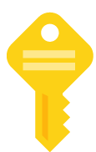
Scenario 4 – Infrastructure as Code for ADB
1
IAC repository
DevOps pipeline
2
3
Test Subscription
4
Prod Subscription
Target cluster

Slide 10
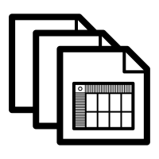



Scenario 5 – Sample forecasting
Sample dataset
1
Databricks jobs
Data Engineer
Databricks notebooks
2
3
Target cluster
Source code repository
Databricks Dashboards

Slide 11

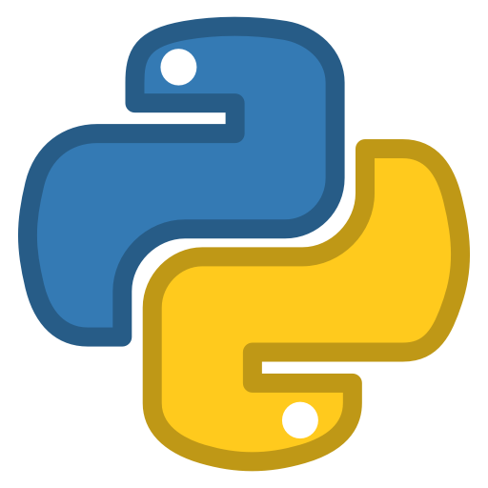


The stack

Slide 12


A cool code name for this project
Cerebro
Lumus

Slide 13
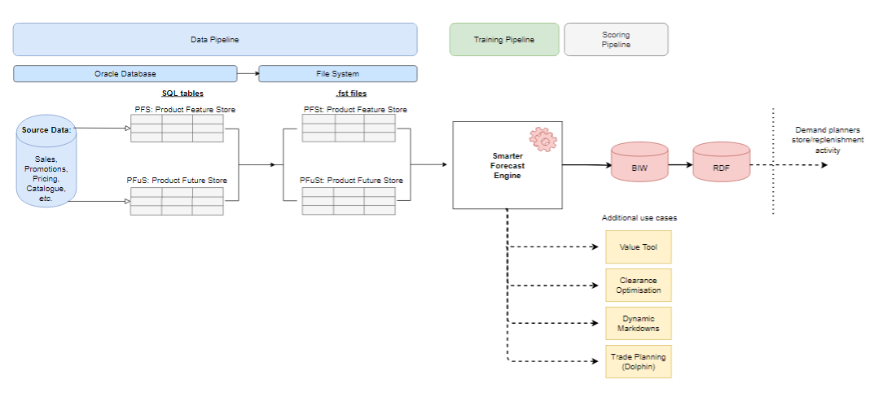
Existing Architecture

Slide 14
Features of an ideal Smarter Forecasting system
Generalisation across savings levels to handle new and unseen promotions
Extension to Down Down/EDV, multi buy and normal price changes
Weekly/Yearly Seasonality (prophet) and Non-Standard learners
Capturing of holiday events
Substitutes and complements
Capture level shifts via time series models and features
Best practice view of ranging data via active_status_cde, pending range, on/off supply dates and sales driving sets

Slide 15

High level requirements
Promo App
The ability to predict the quantity, (and sales) on and off promotions
Ability to score with user defined features
Accurate at a promotion level
Accurate when different promotional mechanics are toggled on and off
Accurate for holidays
The ability to predict the sales of new products after 14 days of sales
Clearance
The ability to score with user defined features
The ability to run duplicate scenarios at the same time
Smarter Forecasts
Prediction for 13 weeks
Model Trained weekly - train up until 4 weeks from the train date, have 4 weeks data to validate
Model scored daily
Bayesian Updation
New stores / new items included

Slide 16

Data sources
Catalogue data
Range and Space (Shelf capacity)
Events
Promotions
Customer
Foundations (Item and store attributes)
Pricing
Seasonality
Weather
Sales
Trading
Substitutions
Trading hours

Slide 17
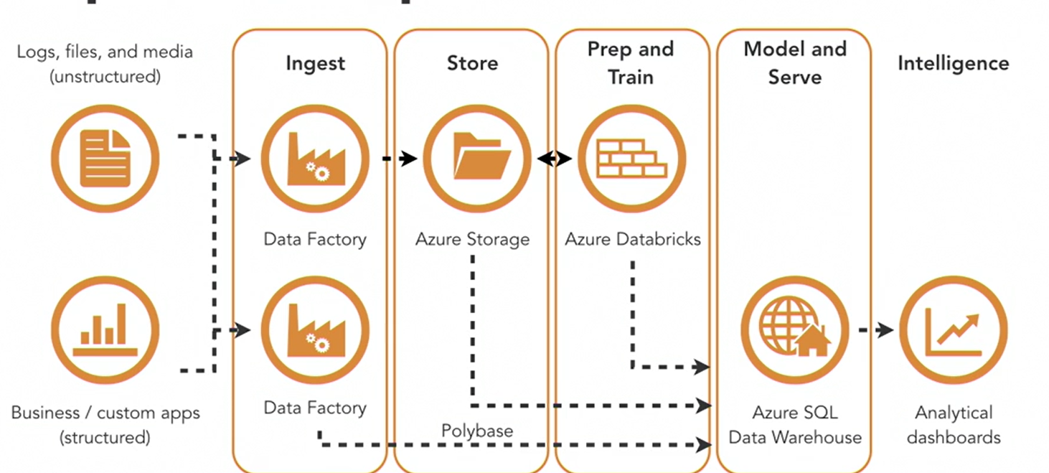
Data pipeline

Slide 18
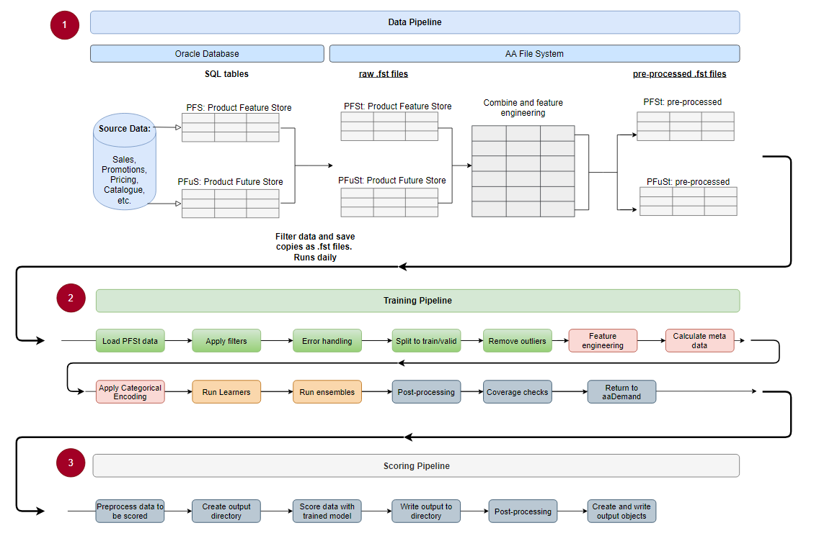
Data Flow

Slide 19
Existing samples on Smart Forecasting
Continuous integration and delivery on Azure Databricks using Jenkins - Azure Databricks - Wor kspace | Microsoft Docs
Continuous integration and delivery on Azure Databricks using Azure DevOps - Azure Databricks - Workspace | Microsoft Docs

